Slide 1
CSS

Slide 2


Slide 3
OVERVIEW

Slide 4
OVERVIEW
The rationale for CSS.
The syntax of CSS.
Where CSS styles can be located.
The different types of CSS selectors.
What the CSS cascade is and how it works.
The CSS box model.
CSS text styling.
Normal page flow.
Positioning and floating.
Multicolumn layouts.
Different page layout approaches.
Responsive design.
CSS frameworks.

Slide 5
BACKGROUND
The rational to Cascading Style Sheets(CSS) is to separate the formatting from the content of HTML.
CSS is a W3C standard for describing the appearing of HTML elements.
CSS let’s us define font, colors, sizes, borders, images, and positioning.

Slide 6

REFERENCE
HTML changes all the time and an excellent documentation reference is the W3Schools at https://www.w3schools.com/css/default.asp.
This reference is one of the best sources of truths on updated HTML, other sites like stackoverflow or geeksforgeeks are secondary sources.
Only use this slide deck as an introduction to the fundamentals to HTML, but use the w3schools link as the true reference when doing development.

Slide 7
BENEFITS
The benefits of separating the style with CSS is for maintainability, readability, performance, and modularity.
CSS is maintainable because all formatting is centralized, making site-wide changes very easy and consistent.
CSS makes HTML readable, because it removes all styles that historically cluttered HTML files.
CSS improves download speeds because HTML has less code to parse on demand.
CSS improves modularity because now that styles are separated into their own files, they can be recycled for other apps and save a ton of rework.

Slide 8
HISTORY
Historically, Netscape first proposed styling pages with JavaScript in 1996.
It later was established that CSS be it’s own language using some fundamental concepts such as CSS selectors, namespaces, media queries, and colors.
CSS is known for being a frustrating language because browsers always had trouble supporting newer versions of it.

Slide 9
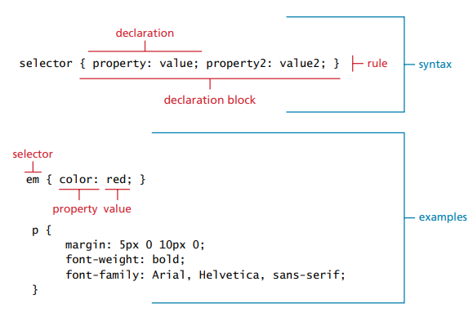
SYNTAX
A CSS stylesheet consists of one or more style rule.
A rule contains a selector that links back to the HTML element(s) that are affected.
A rule also contains a declaration block with property: value pair(s) to define attributes to the style.

Slide 10
SYNTAX
Declaration blocks can be on a single line, or spread across multiple lines if they have more than one declaration.
Each declaration is terminated with a semicolon.
The browser ignores all white space.

Slide 11
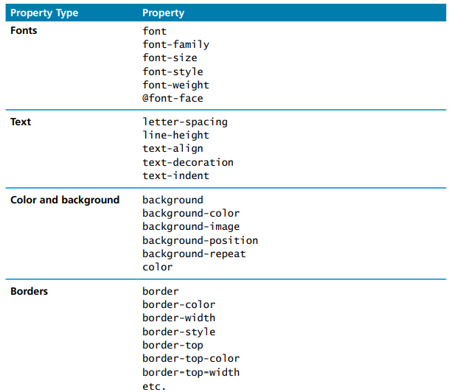
PROPERTIES
Every CSS declaration must contain a property.
CSS properties are all reserved styles and there are over 520 of them.
A list of common properties are listed here.

Slide 12
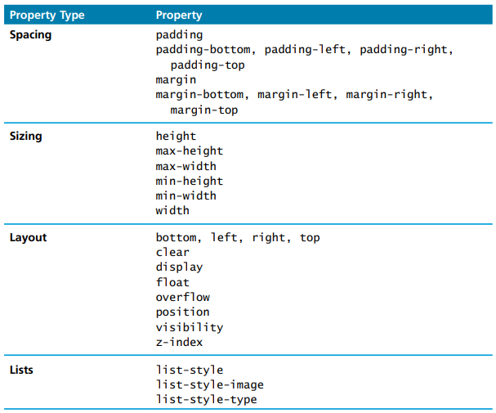
PROPERTIES

Slide 13
VALUES
Each CSS declaration property has a value.
The unit of any value is dependent on their property.
Some values are predefined lists of keywords, others are length measurements, percentages, numbers without units, colors, and URLs.

Slide 14
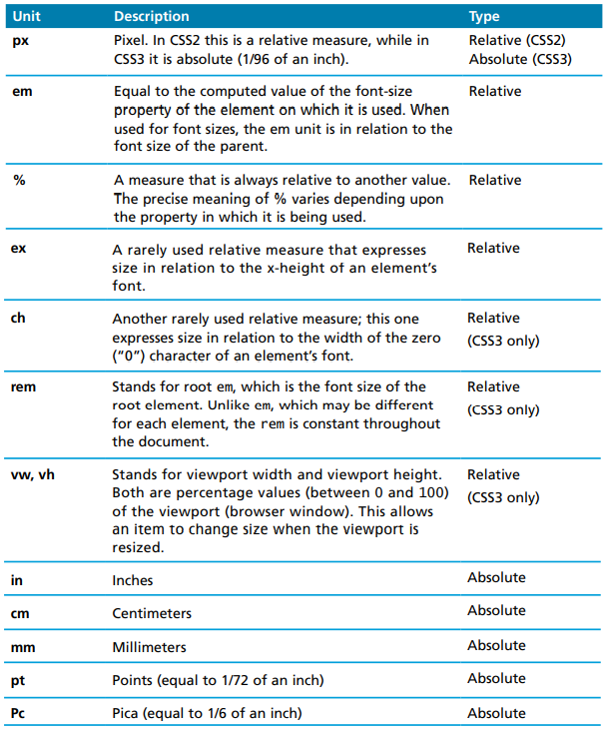
MEASUREMENTS
Measurements can also be represented in different formats.
Units are sometimes absolute, meaning they are static and real-world sizes. This include inches, centimeters, or points.
Other times, they are relative, meaning they depend on other elements to resize. These include em or %.
It is not recommended to use absolute styles, because they don’t resize well to different screen sizes or zooming in and out. They are not good for responsive design.

Slide 15
COMMENTS
Comments in CSS are represented with /* and */ syntax.
This syntax can be used for single line or multi-line comments.

Slide 16
LOCATIONS
CSS can be added directly on the HTML element using an inline style attribute, or within a <style> tag inside the <head> tag of HTML, or as a separate file using a link tag.
They 3 locations are not mutually exclusive, meaning the same styles can be placed in all 3 locations. However, it is not common practice to do that, it is preferred to place them all on a separate stylesheet.

Slide 17
INLINE STYLES
Inline styles are rules placed within HTML elements via the style attribute. A semicolon is used to separate each style.
A selector is not necessary with an inline style.
Inline styles are discouraged because they defeat the purpose of separating the HTML and CSS benefits described earlier i.e. performance, maintainability…etc.

Slide 18
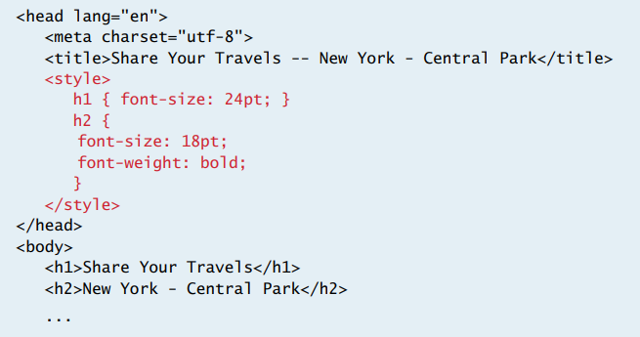
EMBEDDED STYLES
Embedded styles are internal styles that are placed within a <style> tag in the <head> element of the HTML.
Although better than inline styles, they are also discouraged, because each HTML file will have it’s own <style> tag, and can not be shared with other HTML files.

Slide 19
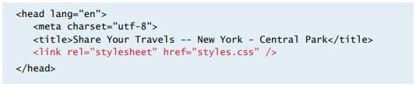
EXTERNAL STYLES
External styles are rules placed on an external .css file.
This is by far the best place to place styles because it provides the best maintainability.
When a change is made to this style, all HTML documents are updated automatically.
The browser caches the external style as well, so it improves the performance of the site.

Slide 20
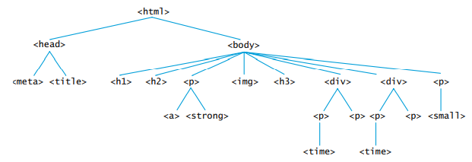
DOM
The document object model(DOM) describes how an HTML page is organized on a page.
It consists of parents, children, and siblings.
A web developer has to understand where they are on the DOM to perform proper manipulations when building a site.

Slide 21
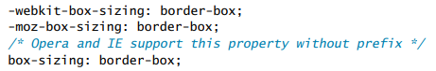
VENDER PREFIXES
Some browsers want to add new CSS properties that are not part of the formal CSS language.
To achieve this, they add their own prefixes on the property. For Chrome and Safari, it’s ‘-webkit’, for Firefox, it’s ‘-moz-’, for IE it’s ‘-ms’, and for Opera it’s ‘-o-’.
One of the controversies with vender prefixes is that it causes browser companies to have more say over the CSS standard than the W3C. This can cause long-term compatibility issues.

Slide 22
SELECTORS

Slide 23
SELECTORS
Every CSS rule begins with a selector.
The selector defines the element(s) that will be affected on the HTML document.
These selectors can be ids, classes, or general tags.
Any part of an HTML document can be connected with a selector.
When picking the name of a custom selector, it’s very important to make sure it is unique, so that it does not confuse with selectors of imported libraries like boostrap or jquery ui.

Slide 24
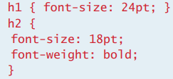
ELEMENT SELECTORS
Element selectors are used to select existing HTML tags.
This includes generic tags like <h1>, <body>, <strong>…etc.
When an element selector is defined as shown on the css, every <h1> tag on the HTML will have the style applied to it.

Slide 25
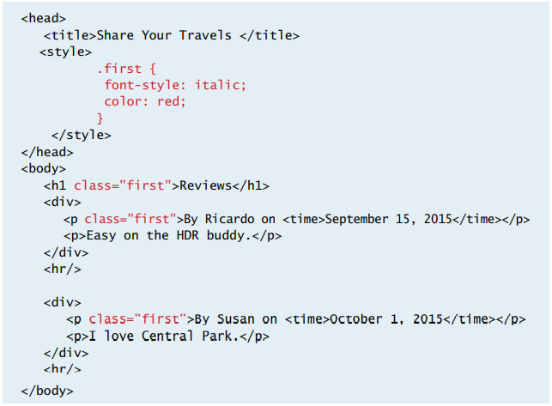
CLASS SELECTORS
If the web master wants to apply styles to more specific elements, they can use class selectors.
The Class selector matches the class name of the style to the class name listed on the attribute of the HTML tags.
The class selector is defined with a period(.) sign in the CSS.

Slide 26
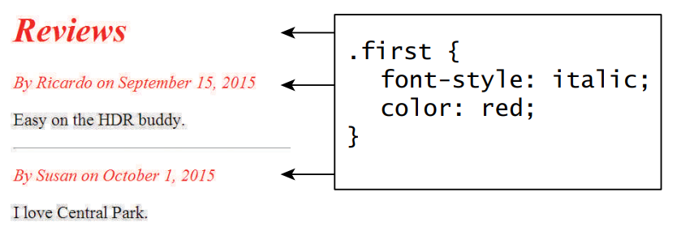
CLASS SELECTOR RENDERED

Slide 27
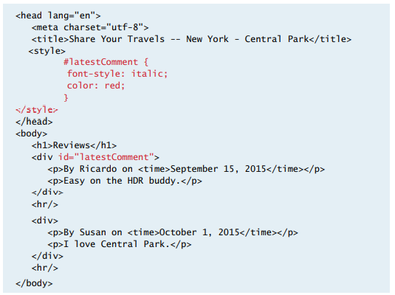
ID SELECTORS
The Id selector is very similar to class selectors, but they are used to target one single specific tag, instead of a collection of tags.
Although most browsers are forgiving, 2 HTML tags should never have the same id attribute.
The id selector is defined with a pound(#) sign in the CSS.

Slide 28
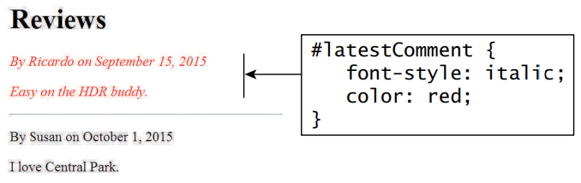
ID SELECTOR RENDERED

Slide 29
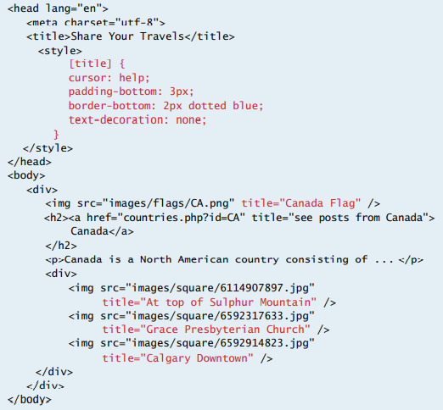
ATTRIBUTE SELECTORS
The attribute selector provides a way to select HTML elements by the presence or value of an attribute. They can match any element with a ‘title’ attribute.
They are very helpful in styling hyperlinks and images.
This selector is not commonly used, because not every browser can support it.

Slide 30
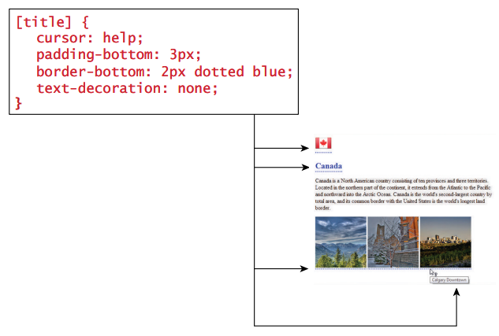
ATTRIBUTE SELECTOR RENDERED

Slide 31
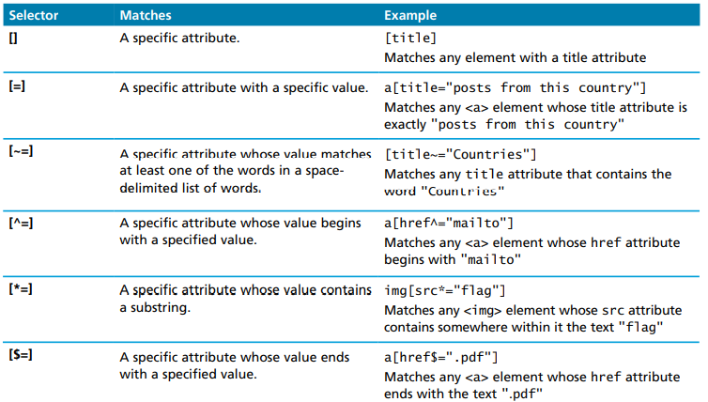
ATTRIBUTE SELECTOR OPERATORS

Slide 32
PSEUDO-ELEMENT SELECTORS
The pseudo-element selector is added to a master selector to change HTML elements on runtime.
Pseudo-element selectors do not bind by a hard-coded selector, they can bind by user events or DOM locations amongst many others.
Pseudo-element selectors require the colon(:) to separate the master selector and the pseudo-class element.

Slide 33
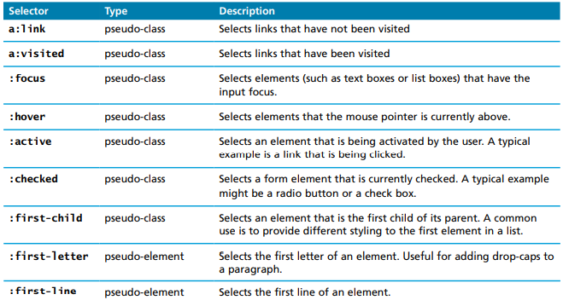
PSEUDO-ELEMENT SELECTORS

Slide 34
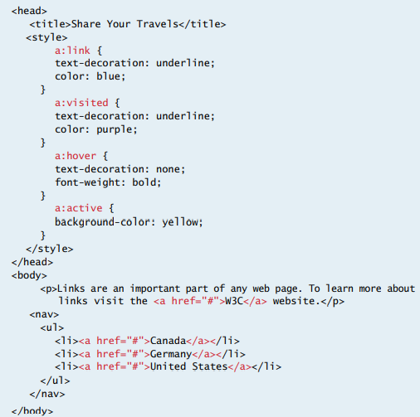
PSEUDO-ELEMENT SELECTORS

Slide 35
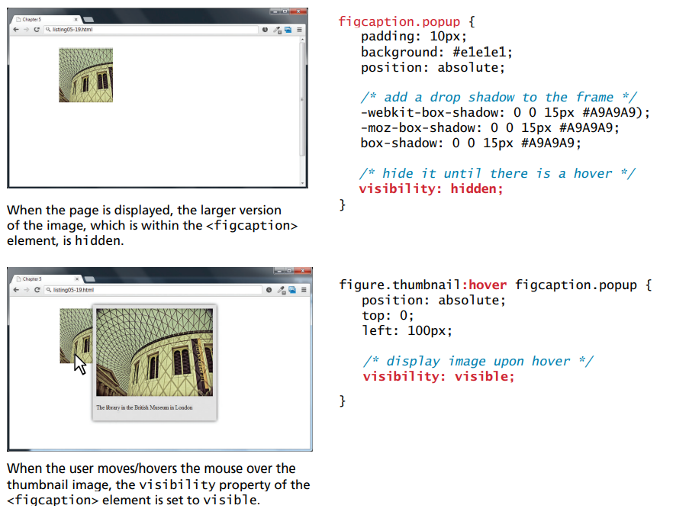
HOVER EXAMPLE

Slide 36
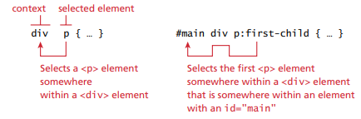
CONTEXTUAL / DESCENDENT SELECTORS
The contextual / descendent selector is used to select elements based on their location in the DOM.
They can be used to traverse to a parent, child, or sibling.

Slide 37
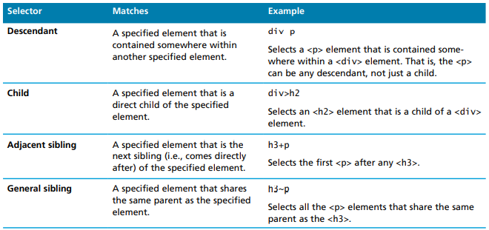
CONTEXTUAL / DESCENDENT SELECTORS

Slide 38
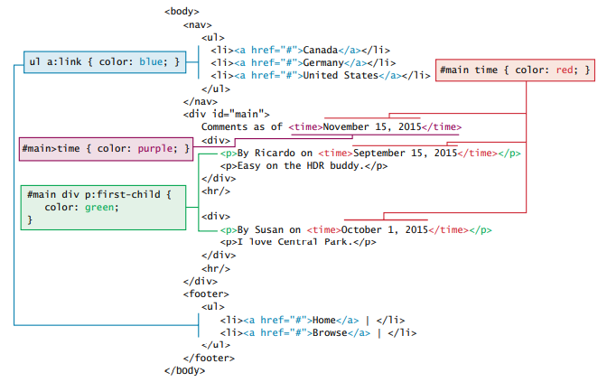
CONTEXTUAL / DESCENDENT SELECTORS

Slide 39
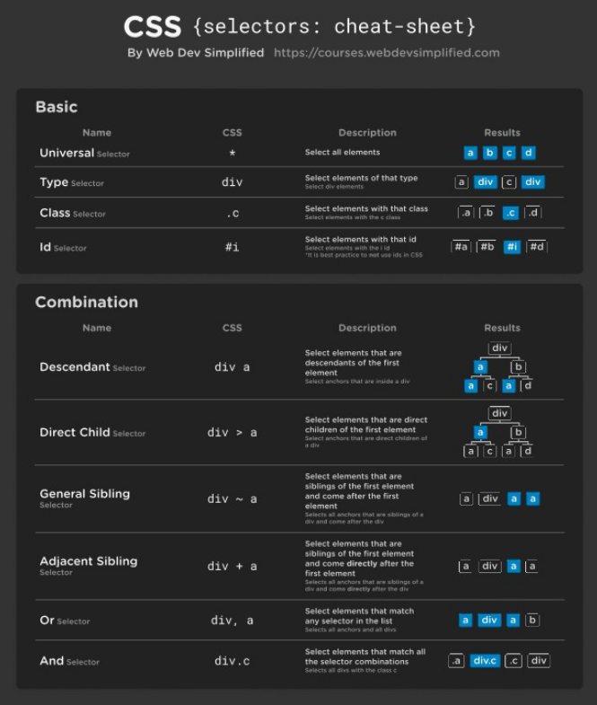
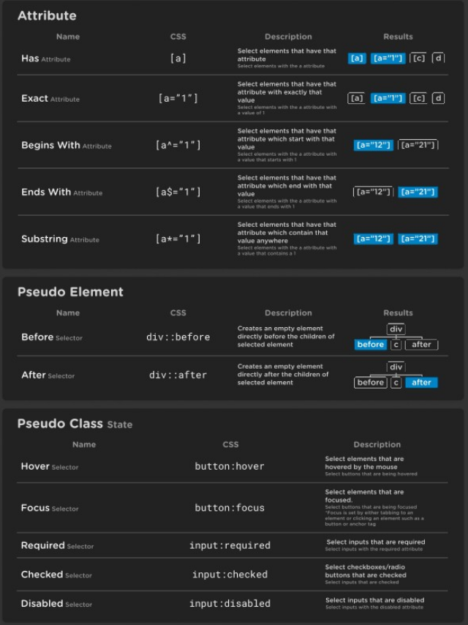

Slide 40
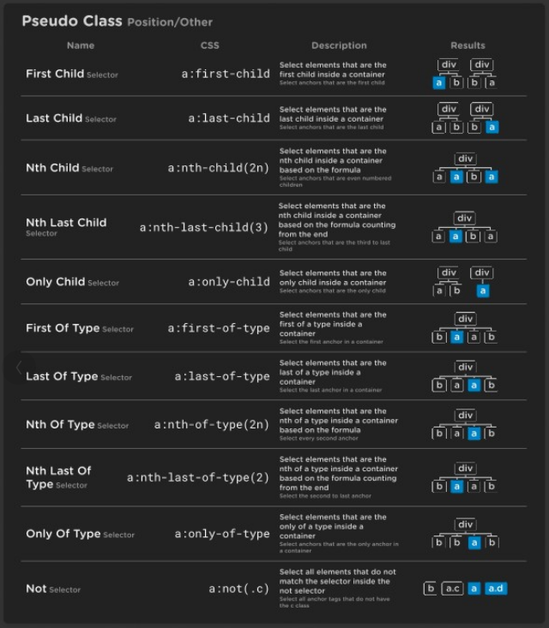

Slide 41
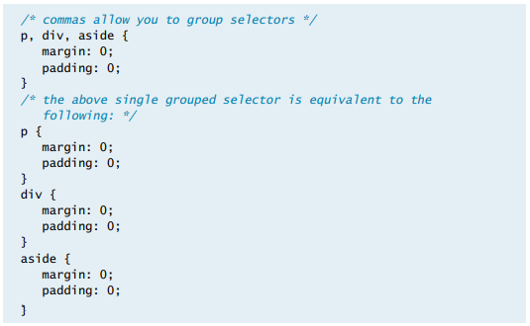
GROUPING
CSS styles can be applied to multiple selectors by using a comma.
This reduces redundancy which is better for maintainability.

Slide 42
COMBINATORS
Combinators are used to select certain tags that have a certain relationship together.
It’s important to note that a browser will traverse the combinators from right to left, instead of left to right.
This is because it is more efficient for the browser to run this way, because checking a parent has a lower chance of matching a child than checking a child directly when you study tree traversals.

Slide 43
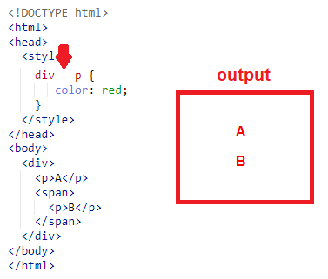
DESCENDANT COMBINATOR
The descendant selector recursively selects all children of a parent element.

Slide 44
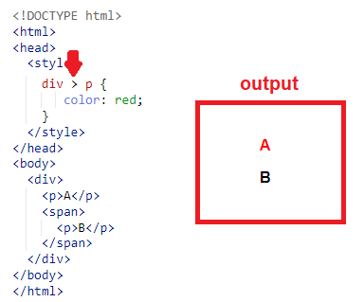
CHILD COMBINATOR
The child selector selects only 1 layer of children of parent element.

Slide 45
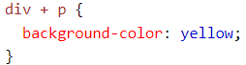
ADJACENT SIBLING COMBINATOR
The adjacent sibling selector is used to select an element that is directly after another specific element.

Slide 46
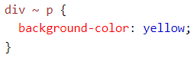
GENERAL SIBLING COMBINATOR
The general sibling selector selects all elements that are next siblings of a specified element.

Slide 47
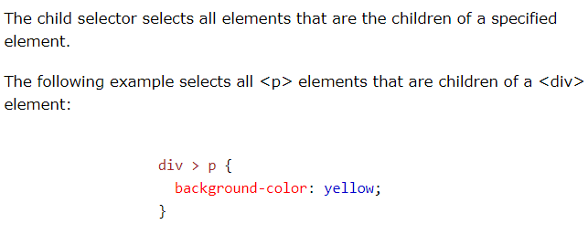
CHILD COMBINATOR

Slide 48
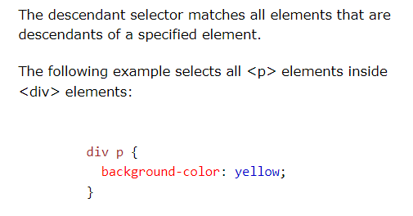
DESCENDANT COMBINATOR

Slide 49
CASCADE

Slide 50
THE CASCADE
One of the common issues with CSS is that some styles will often overlay another. There may be a tag linked to several different style sheets, that has a style linked to its class, and another style linked to its id.
The ‘cascade’ in cascading style sheets(CSS) is the idea of resolving these conflicting styles by reviewing the location of elements in the DOM.

Slide 51
INHERITANCE
Some CSS properties like font, color, list, and text are inheritable, meaning descendant tags will inherit those properties.
Other CSS properties like layout, sizing, border, background, and spacing are not. Meaning their styles will apply to their element only.

Slide 52
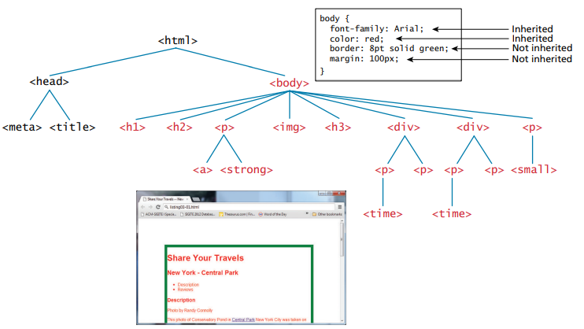
INHERITANCE

Slide 53
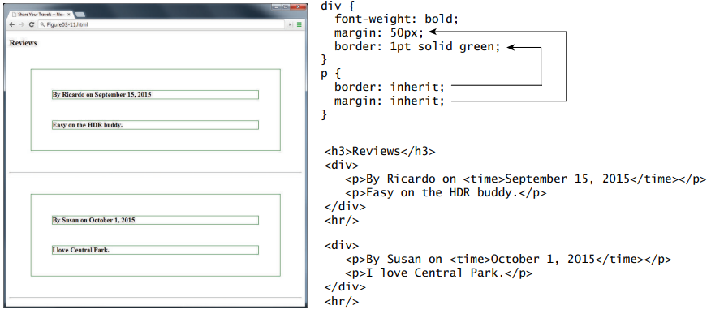
INHERITANCE
It’s possible to make styles inherited by using the ‘inherit’ value.

Slide 54
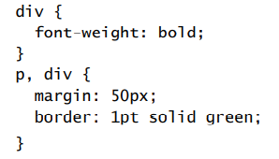
INHERITANCE
If the web master does not want to use inheritance in the previous example, they can code the style on the child nodes as shown below, and the results would be the same.

Slide 55
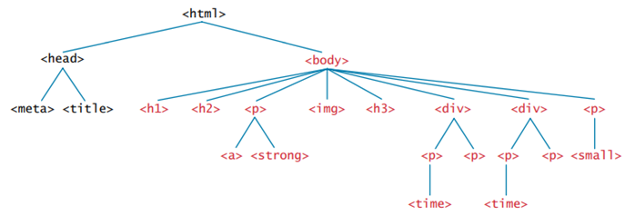
SPECIFICITY
Specificity is the process of determining style precedence when more than one style is applied to an element.
The more specific the selector, the more precedence it has.
In general, nodes that are lower in the DOM(more child) have higher say than more generic parent nodes.
Also, class selectors have precedence over element selectors and id selectors have precedence over class selectors.
more precedence

Slide 56
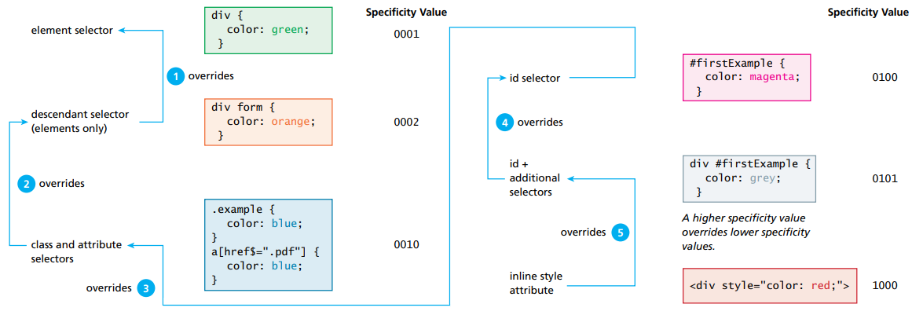
SPECIFICITY FLOW DIAGRAM
The actual algorithm used to determine specificity is complex, and can be summarized in this diagram.

Slide 57
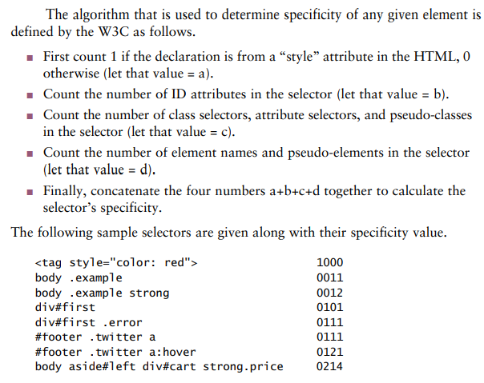
SPECIFICITY COUNT ALGORITHM
Browsers assign weights to each style. The one with the highest weight gets the final say and override all other styles.
The official W3C counting algorithm is shown in the diagram.

Slide 58
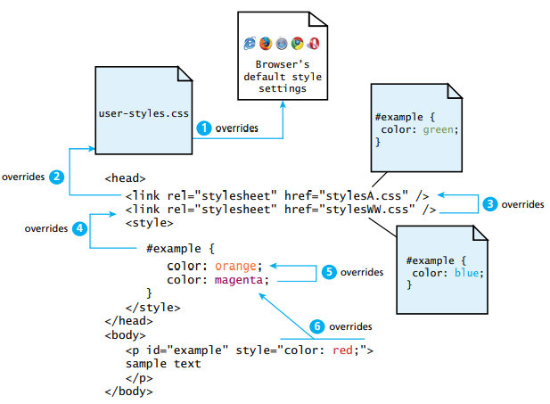
SPECIFICITY ON LOCATION
An inline style will override an embedded style and an embedded style will override an external style.

Slide 59
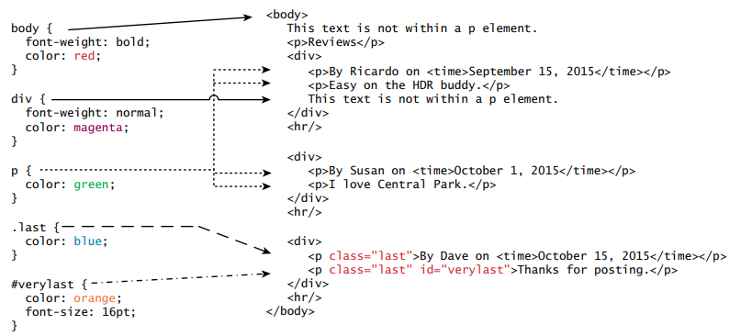
SPECIFICITY ON SELECTOR

Slide 60
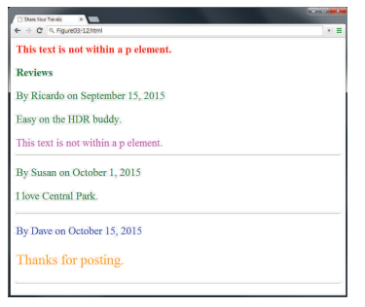
SPECIFICITY ON SELECTOR

Slide 61
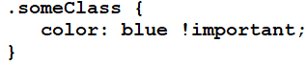
SPECIFICITY WITH !IMPORTANT
If the web master wants a CSS tag to override any existing style, regardless of their location or selector, they can use the !important syntax.
This trick is used often in web development, but it is sometimes seen as ‘patchy’ and not encouraged. It is best to set precedence by using the natural hierarchical location and selector methods described previously.

Slide 62
BOX MODEL

Slide 63
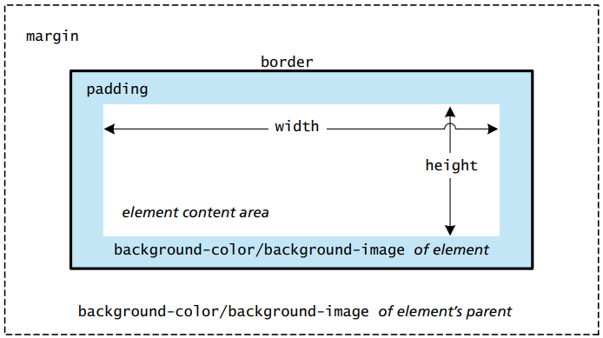
THE BOX MODEL
In CSS, all HTML elements exist within an element box.
Every style defined will apply to each of these boxes.
Boxes are often referred to as containers in web development.

Slide 64
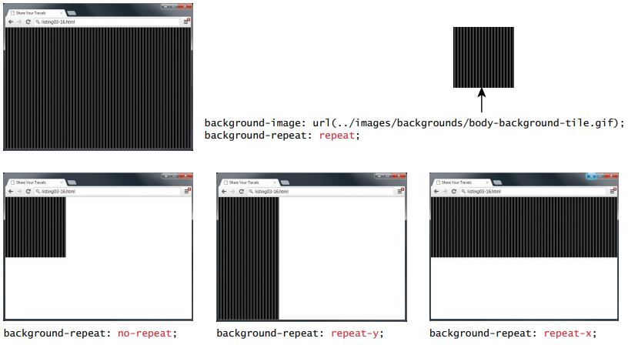
BACKGROUND STYLE

Slide 65
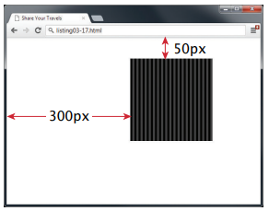
BACKGROUND STYLE

Slide 66
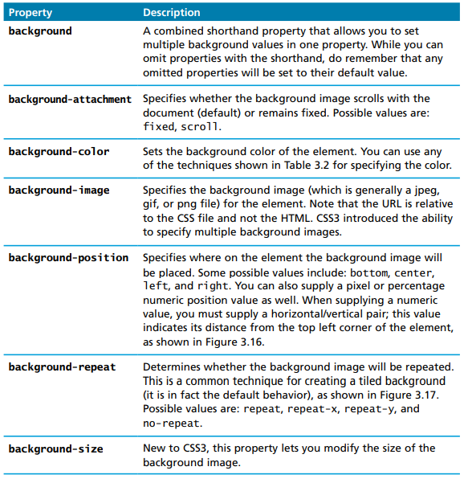
BACKGROUND STYLE
Background styles are used to define how the background will look on the box elements.
This can be defined with colors or images.

Slide 67
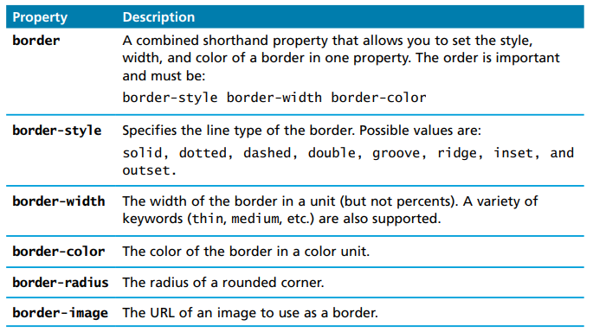
BORDERS
Borders provide a way to visually separate elements.
You can set borders around all four sides of an element.

Slide 68
MARGINS AND PADDING
Margins and padding are essential for adding white space to a web page, they help differentiate one element from another.
Margin adds space outside an element and padding adds space inside an element, and borders divide the margin area from the padding area.

Slide 69
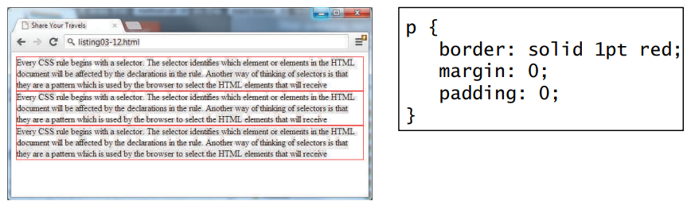
BORDER EXAMPLE

Slide 70
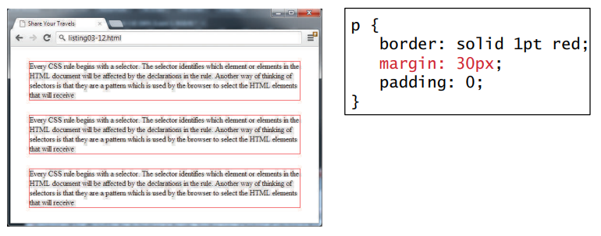
MARGIN EXAMPLE

Slide 71
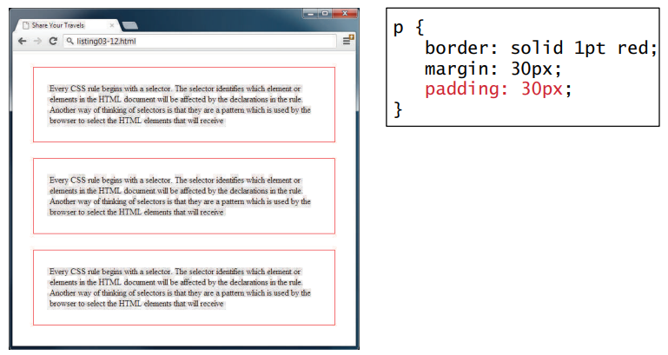
PADDING EXAMPLE

Slide 72
VERTICAL MARGIN COLLAPSE
The adjoining margins of 2 or more boxes can combine to form a single collapsed margin.
When a collapse occurs, only the largest value is displayed, while the smaller margin is collapsed to zero.
Horizontal margins never collapse.
This collapsing phenomenon has been the source of headaches for many web masters troubleshooting CSS.

Slide 73

VERTICAL MARGIN COLLAPSE

Slide 74

DIRECTIONAL STYLES
Borders, margins, and paddings can either be styled to each direction specifically or styled to all 4 directions at once as shown below.

Slide 75

DIRECTIONAL STYLES
Another way to define all 4 sides in one line is by listing each value separated by a space.
CSS will take all 4 arguments and run them clock-wise from top, right, bottom, and left.
If only 2 arguments are provided, the 1st argument will apply to the top and bottom border, and the 2nd argument will apply to the left and right border.

Slide 76
BOX DIMENSIONS
The sizes of each element box can be defined specifically.
By default, the size of the box is determined by the size of its content plus its padding.
These values can be overwritten with specific width and height values.
The style box-sizing can be used to eliminate the border width from the box dimensions.

Slide 77


BOX SIZING

Slide 78

COLORS
Colors can be represented in many different ways such as RGB, hexadecimal, and HSL.
These color methods have their pros and cons depending on the IDEs and browsers used.

Slide 79

COLORS
Colors can also be defined using the name of the color.
The color must be spelled exactly to the documentation.
An example syntax would be <span style=‘color: red’></span>

Slide 80

OVERFLOW
The overflow property is used to easily display elements that are too large to fit in their containers. This is achieved by adding scrollbars.
Scrollbars can be hand customized as well using specialized CSS.

Slide 81

TEXT STYLING

Slide 82

TEXT FONT
Browser fonts can read from user desktop computers or from an external link.
If a font doesn’t exist, it is important to define a backup one using a web font stack. These alternatives are all separated by commas.

Slide 83

TEXT FONT

Slide 84

FONT-FACE
Importing external fonts can be done by inserting the link directly on the page or by using the font-face selector as shown.
Some of the common font sources are google web fonts and font squirrels.

Slide 85
TEXT SIZE
A font size of 12pt = 1/6 of an inch when printed.
A font size of 72pt = 1inch when printed.
Pixel to inch ratios do not always correlate the same depending on the pixel density of the device used. This is why em and percentage units are better for font sizing.
The em property is relative to their parent elements, whereas rem is relative to the size of the root element.

Slide 86

TEXT SIZE

Slide 87

TEXT STYLES

Slide 88
POSITIONING

Slide 89
PERCENTAGES
Sizes can be determined with pixels or percentages.
Percentages are relative to the size of the parent element.
The purpose of using percentages is to make apps scalable and responsive to the browser device.
Expanding these values can sometimes cause scaling issues that are often controlled with min-width, min-height, max-width, and max-height.

Slide 90

PERCENTAGES

Slide 91

PERCENTAGES

Slide 92

PERCENTAGES AND EM

Slide 93

REM

Slide 94
NORMAL FLOW
The concept of normal flow refers to how block-level and inline elements display from left to right and from top to bottom.
Elements that are block-level are each containing in their own line with a line break, while elements that are inline are not displayed in their own blocks.

Slide 95


BLOCK VS INLINE

Slide 96

BLOCK VS INLINE

Slide 97

BLOCK VS INLINE

Slide 98

BLOCK VS INLINE

Slide 99

POSITIONING
Positioning is used to move containers around a page.
This is done using absolute, fixed, relative, or static positioning.
Relative and static are encouraged because they are more responsive.

Slide 100


POSITIONING

Slide 101
Z-INDEX
The z-index is used to specify the order at which an element is overlaid on a page.
The higher the z-index, the farther front the element is displayed.
The lower the z-index, the farther back the element is displayed.

Slide 102


Z-INDEX

Slide 103

FLOATING
The floating element is used to displace containers out of their flow.
When floating, it is important to set a width, otherwise it will take the entire width of the window.

Slide 104


FLOATING

Slide 105

FLOAT RESIZING
One of the issues with floats is when a page is resized, the elements tend to shuffle, instead of staying in order.
This can cause a messy layout.

Slide 106

CLEAR
The clear property is used to properly align elements when resizing.
The class is assigned to the element that will likely start on a new line.

Slide 107

CLEAR

Slide 108

FLOAT CONTAINMENT
When an element is floated within a containing block, the containing block disappears.
In the example shown, a <figure> containing block contains only an <img> and <figcaption> element, and both are floated to the left.

Slide 109

FLOAT CONTAINMENT
To resolve the containment issue, the overflow property is often set to auto.
The clearfix property is also used to fix similar containment issues.

Slide 110

DISPLAY VS VISIBILITY
Elements can be hidden using the display and visibility properties.
The only difference is that the visibility property will maintain the state of its positioning context, i.e. its parent element.

Slide 111
LAYOUTS
A page layout describes how each container will be positioned in a page.
These containers can include banner bars, footers, headers, trees, tables,…etc.
When building pages, it is more common to use floats than tables.

Slide 112


LAYOUT EXAMPLES

Slide 113


LAYOUT EXAMPLES

Slide 114

LAYOUT EXAMPLES

Slide 115

LAYOUT EXAMPLES

Slide 116

LAYOUT EXAMPLES

Slide 117

LAYOUT EXAMPLES

Slide 118

LAYOUT EXAMPLES

Slide 119
RESPONSIVE DESIGN
As described previously, CSS also must use responsive design to adapt to multiple screen sizes.
It is best to use liquid layouts(ex: calc(100%)) instead of a fixed layout(ex: width: 960px) for proper responsive design.

Slide 120

FIXED LAYOUT PROBLEMS

Slide 121


FIXED LAYOUT PROBLEMS

Slide 122

LIQUID LAYOUTS

Slide 123

RESPONSIVE LAYOUTS
Responsive layouts are similar to liquid layouts but they can scale images down when the page shrinks.
Liquid layouts only scale down widths of containers.

Slide 124

RESPONSIVE LAYOUTS

Slide 125


VIEWPORTS
Viewports are used to define the size of the page by the size of the device.
By using this, no scaling is required.
There are many CSS alternatives that can work as well as the viewport.

Slide 126

MEDIA QUERIES
A media query is used to apply styles based on the device it is displayed on.
These queries can be used to determine the capabilities of the device, and define CSS styles to target that device.
Not every browser supports media queries.

Slide 127

MEDIA QUERIES

Slide 128

MEDIA QUERIES

Slide 129

MEDIA QUERIES

Slide 130
OTHER

Slide 131
CSS FRAMEWORKS
Large companies have relied on frameworks to make CSS layouts more consistent.
A CSS framework consists of classes and tools to make CSS work easier. They have 2 main types: (1)grid systems and (2)CSS preprocessors.
The most popular frameworks are bootstrap, blueprint, and 960.
Bootstrap is the most popular one and was created by the designers of Twitter. It provides styles for grids, buttons, dropdowns, and many more.
https://getbootstrap.com/docs/5.1/getting-started/introduction/

Slide 132

CSS PREPROCESSORS
A CSS preprocessor is a tool that adds logic to CSS. It adds programming concepts like variables, inheritance, calculations, and functions.
The problem with CSS is that a lot of styles are hard-coded, and when changes are required, maintainability is not easy.
By using variables and nesting, making an application-wide style change becomes an instant modification.
Some examples include SASS and SCSS. They add more features to CSS like variables and nesting.

Slide 133
ICONS
Selecting icons is a big part of web development to add clarity and professionalism.
One of the most common libraries for icons is font awesome.
To insert an icon, the webmaster can add the following syntax to their page <i class=‘fa fa-fw fa-pencil’></i>.
The ‘fa-fw’ syntax is used to define a fixed width so that all icons have the same size.
It’s important to always pick an appropriate icon for the task.

Slide 134







ICONS
It’s important to always pick an appropriate icon for the task.
Below is a list of some of the most common icons.

Slide 135

TROUBLESHOOTING WITH DEV TOOLS

Slide 136


